Slide 1

NYAGA DOMINIC & CO. ADVOCATES
Legal and Advisory
Clarity. Structure. Judgment.
ndcadvocates.com

Slide 2
The Firm
Nyaga Dominic & Co. is a Nairobi-based legal and advisory practice serving corporates, investors, institutions, and public-sector actors on complex legal, regulatory, and cross-border matters across East Africa and internationally.
Clarity.
Structure.
Judgment.
The practice is built on a single principle: serious legal problems require structured thinking, and the most valuable advice is not the most voluminous. The firm works on matters where analytical clarity and institutional judgment create measurable outcomes.
Its advisory foundation spans banking and project finance, technology regulation, cross-border structuring, AI governance, and institutional advisory; reflecting the reality that consequential legal questions rarely sit within a single practice area.
THE FIRM
ndcadvocates.com

Slide 3
What We Do
PRACTICE AREAS
SECTORS
Cross-border Commercial Advisory
Infrastructure and Development
Regulatory and Legislative Advisory
Financial Services
Projects and Infrastructure
Technology and Digital Regulation
Dispute and Risk Strategy
Public Sector and Governance
AI and Technology Advisory
Cross-Border Investment
Private Capital
ndcadvocates.com

Slide 4
Why Nyaga Dominic & Co.
International Rigour, African Grounding
Judgment-Based, Not Volume-Based
Harvard-trained. New York experienced, East African in practice. The firm brings international-grade analytical discipline to Nairobi-based and cross-border advisory work across the region and beyond.
The firm does not compete on scale. It competes on the quality of its analysis. Advice is specific, structured, and directed at enabling a decision — not filling a file.
Cross-Sector Depth
Institutional Engagement
Experience spanning banking and project finance, AI governance, regulatory advisory, cross-border structuring, and institutional advisory: across Kenya, East Africa, the United States, Asia and beyond.
Berkman Klein Center (Harvard). High-level convenings on governance and constitutionalism. Op-ed columnist in the Business Daily.
ndcadvocates.com

Slide 5
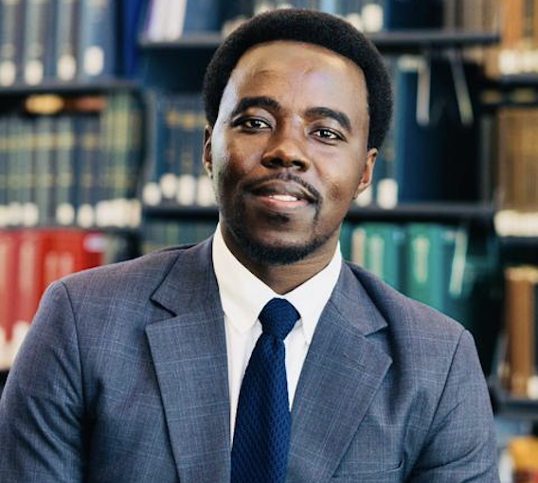
CONTACT THE FIRM
To discuss a matter or instruct the firm,
please contact us directly.
LEAD COUNSEL
Email
dominic.nyaga@ndcadvocates.com
Nyaga Dominic
Telephone
+254 142 491 814
Advocate of the High Court of Kenya
Lead Counsel, Nyaga Dominic & Co. Advocates
WhatsApp
+254 142 491 814
Address
90 JGO, 2nd Floor, James Gichuru Road
Lavington, Nairobi, Kenya
Master of Laws, LL.M., Harvard Law School
LL.B. (Honours), Strathmore University School of Law
Hours
Mon–Fri: 8:30 a.m. – 6:00 p.m.
Saturday: 8:30 a.m. – 2:00 p.m.
Chief Justice C.B. Madan QC Laureate
Legal Researcher, Berkman Klein Center, Harvard University
Web
www.ndcadvocates.com
Lawyer, TripleOKLaw LLP (Meritas Worldwide)
Fees structures are determined based on the scope, complexity and jurisdictional nature of the engagement, and are available upon request.
Legal Counsel, New York
CLA Legal Tech and Innovation Committee
Clarity. Structure. Judgment.

